Slide 1
What is accelerated reader?
A way of measuring your reading progress for both you and us.
A way of guaranteeing you are reading books that aren’t too easy or too hard for you.
A programme with thousands of books available to you in the LRC, online, from other libraries, and beyond!
An interactive way of testing yourself on what you have read.

Slide 2
How does it work?
Your logon is the same as your school logon.
You took a Star Assessment in your English lesson to get your baseline (ZPD) in the spring.
In the LRC, several books have now got coloured dots on. These tell you what ZPD range they’re in, so you’ll know which ones to choose.
As you don’t have access to the LRC at the moment, you can check to see if your own books are on the AR programme using arbookfind.co.uk
You’ll also have access to MyOn, an online area for thousands of books.

Slide 3
Then what???
When you’ve finished a book, you need to take a quiz, ideally within 24 hours. This can be done at home (ideally) or at school.
In form time, your form teacher may let you out to take a quiz – you need to get a pass from them (don’t forget to give it back!).
Each time you quiz, it will tell you how much your reading has progressed. Eventually, your ZPD will improve, and you can move on to more challenging books!
The more you read, the more you’ll quiz; the more you quiz, the more you progress; the more you progress with AR, the more you should see improvement across SEVERAL subjects.
You can get certificates, prizes and treats for your progress and effort!

Slide 4
STAFF AND STUDENT PORTAL VLE

Slide 5
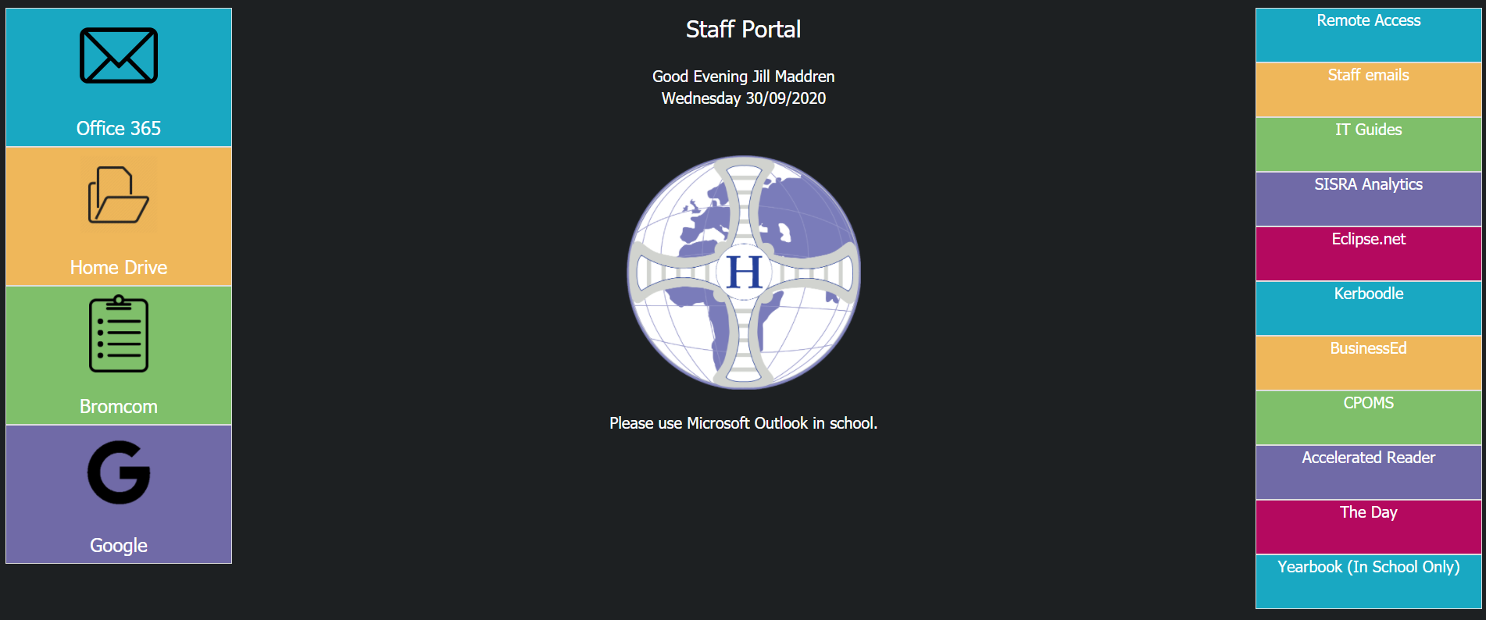

Slide 6
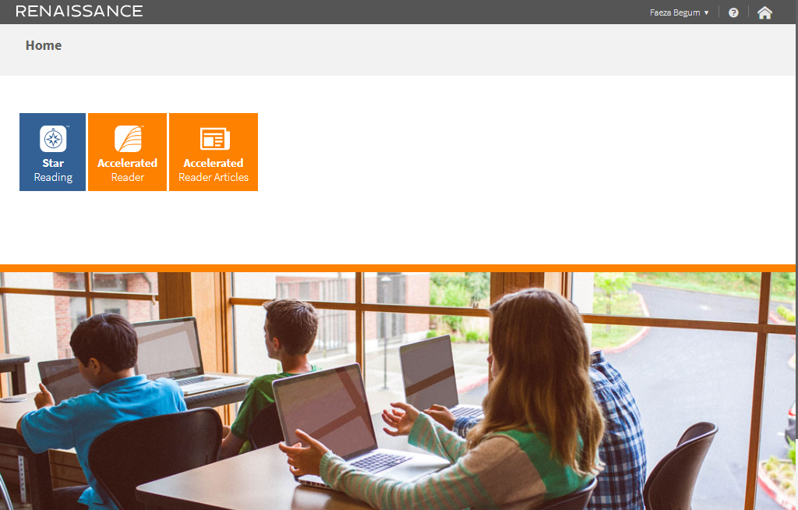

Slide 8
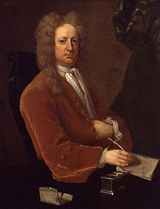
Exercise your mind!
“Reading is to the mind what exercise is to the body”
Joseph Addison (1672-1719)

